Slide 1



Make it look easy.

Slide 2


Mistakes are proof that you are trying
The

Slide 3


I can
I will
AND

Slide 4

Embracing the Ignored
Campaign by Tesla

Slide 5
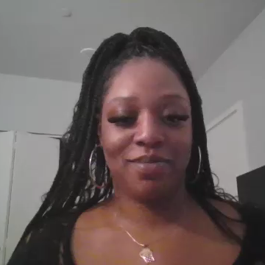
The innovation podcast Ft. Jocelynn Dortch, SVP of Creative and Communications at Tesla

